Slide 1
Models of the Solar System

Slide 2
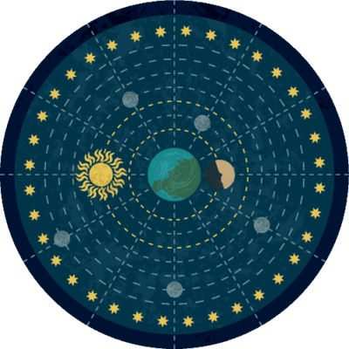
By the end of this lesson you should be able to:
1. | State where the geocentric model places Earth.
2. | State where the heliocentric model places Earth.
3. | Discuss which model we now think is correct.

Slide 3
For thousands of years it was believed that Earth was the centre of the universe and everything else revolved around it.
The planets and Sun were thought to revolve around the Earth in circular orbits.
This theory was accepted because it matched what people could see in the night sky.

Slide 4
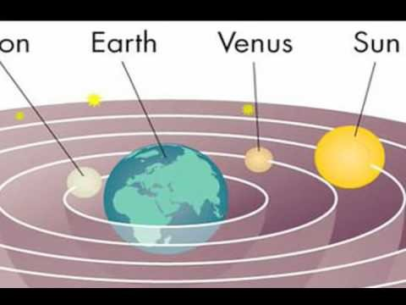
This vision of the universe is called the geocentric model.

Slide 5
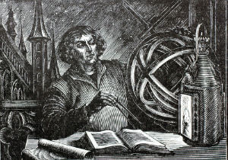
The heliocentric model
In the 15th century, astronomers such as Copernicus noticed that the observed movement of the planets could not be properly explained by the geocentric model.

Slide 6
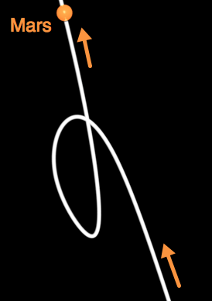
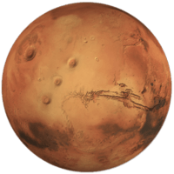
While stars appeared to move around the Earth as expected, the other planets moved in strange ways.
Using tools like the astrolabe (the telescope wasn't invented until 1608), astronomers charted the position of Mars across the sky over a two-month period. It made a path like the one shown below - it seemed to loop back on itself!

Slide 7
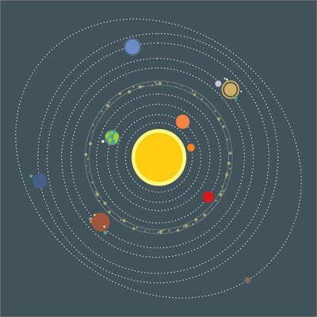
Observations of the other planets disproved the geocentric model, which means it was wrong.
It was proposed that Earth, along with the other planets in the solar system, orbited the sun. Today we call this theory the heliocentric model.

Slide 8
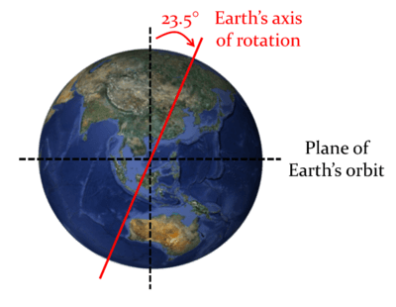
Copernicus and other astronomers also proposed that the Earth rotated on its axis to account for the movement of stars.
It kept the idea that the Moon orbited the Earth.
The Catholic Church was strongly opposed to the new theory, because they believed that God had placed Earth at the centre of the universe.

